Slide 1

Control System Project and Dissertation
A Comparative Study of Reinforcement Learning in SAC and PPO Algorithms for Reservoir Water Level Control Simulation
Supervisor : Dr. J Anthony Rossiter
Muzhaffar M. Ibrahim
27th August 2024

Slide 2
Overview
1. Introduction
2. Literature Survey
3. Methodology
4. Result
5. Discussion

Slide 3
1. Introduction
Aims and Objective :
Analyse the theoretical underpinnings that differentiate exact solution methods between SAC (Q-value Iteration) and PPO (value iteration).
Model an environment for a water reservoir system to evaluate and compare the control performance of Soft Actor-Critic (SAC) and Proximal Policy Optimization (PPO) algorithms.
Develop a simulation environment for a water reservoir system
Conduct a series of experiments to compare SAC and PPO regarding control performance, learning efficiency, and policy adaptability.

Slide 4
2. Literature Survey
2.1. Reinforcement Learning
2.2. System Structure
2.2.1. Single-Tank Model
2.2.2. Quadruple-Tank Model

Slide 5
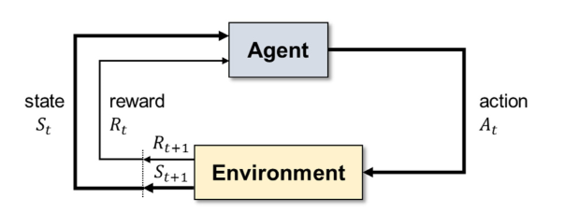
2.1 Reinforcement Learning
Markov Decision Process (MDP)
Figure 1. MDP Workflow

Slide 6
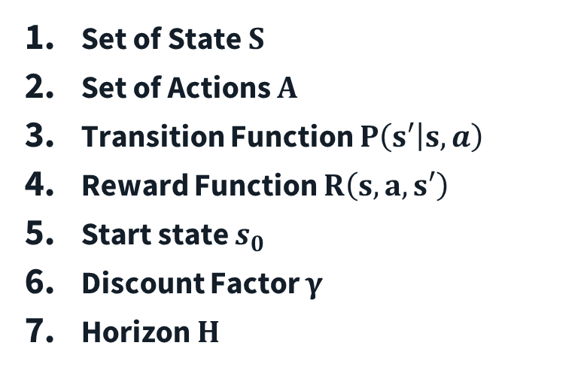
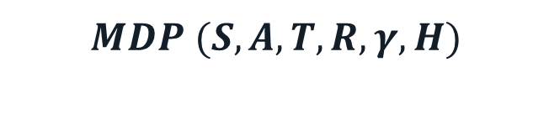
2.1 Reinforcement Learning
Set of State $S$
Set of Actions $A$
Transition Function $P\left(s′ | s,a\right)$
Reward Function $R\left(s,a,s′\right)$
Start state $s_{0}$
Discount Factor $γ$
Horizon $H$
$$MDP (S, A, T, R, γ, H)$$

Slide 7
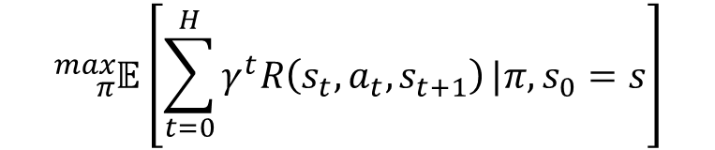
2.1 Reinforcement Learning
Maximize expected discounted reward overtime.
To search the best policy π to maximize expected discounted reward.
$${}_{π}^{max}𝔼\left[\sum_{t=0}^{H}{γ^{t}R\left(s_{t},a_{t}, s_{t+1}\right)}|π,s_{0}=s\right]$$

Slide 8
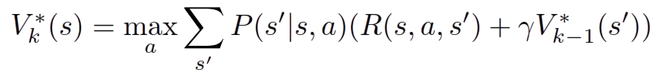
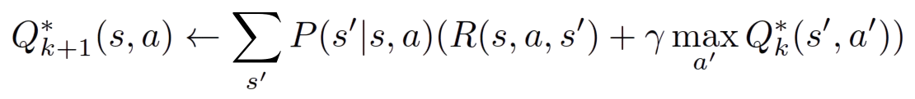
2.1 Reinforcement Learning
The concept of exact solution method divided into 2 different approximation
Value Iteration:
PPO
Q-Value Iteration:
SAC and DDPG

Slide 9
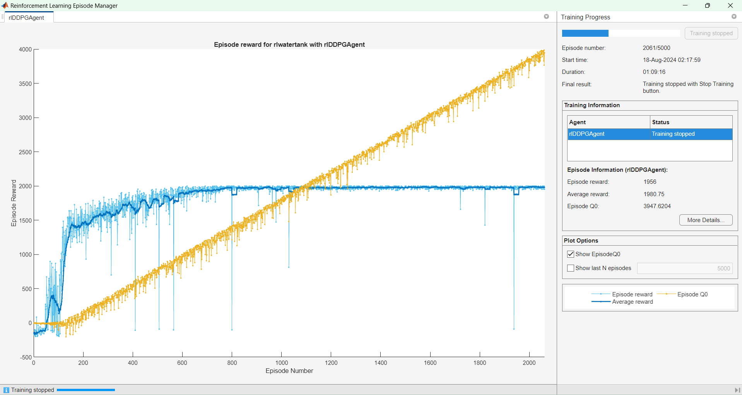
2.1 Reinforcement Learning
Episode Q0
Average Reward
Figure 2. Training Monitor

Slide 10
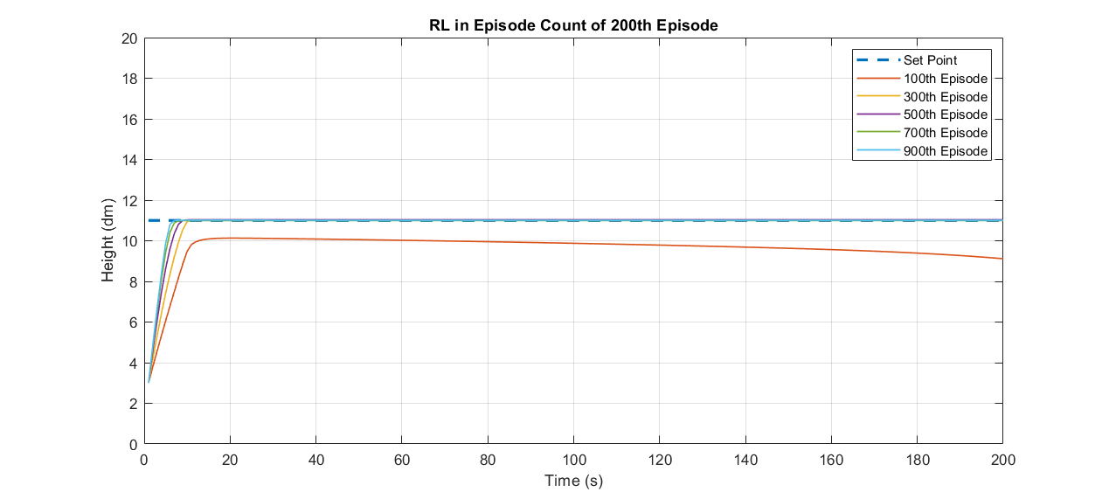
2.1 Reinforcement Learning
Set Point

Slide 11
2.1 Reinforcement Learning
 | 100th Episode | 300th Episode | 500th Episode | 700th Episode | 900th Episode
Rise Time | 6.3 s | 6.8 s | 6.1 s | 5.3 s | 4.8 s
Settling Time | 177.3 s | 8.2 s | 7.6 s | 6.8 s | 6.4 s
Overshoot | 0.02 | 0.03 | 0.0017 | 0.021 | 0.021
Undershoot | 0 | 0 | 0 | 0 | 0
Peak | 9.3 | 10.03 |  | 10.02 | 10.03
Peak Time | 18 s | 9 s | 9 s | 10 s | 11 s

Slide 12
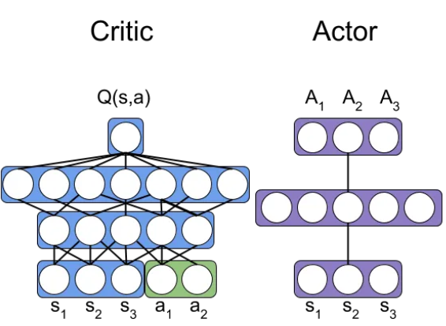
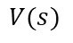
2.1. Reinforcement Learning
$$V(s)$$

Slide 13
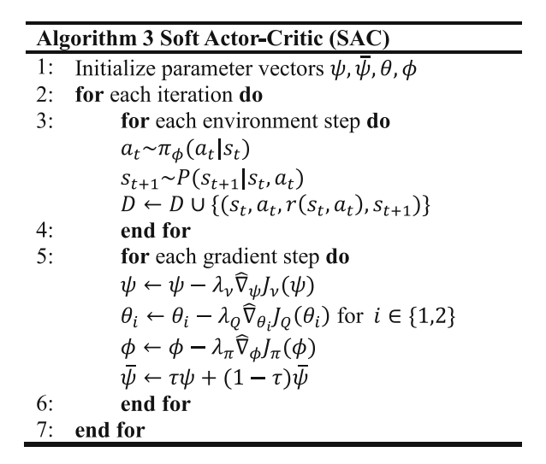
2.1.2 Soft Actor-Critic
Figure 5. Pseudocode of SAC

Slide 14
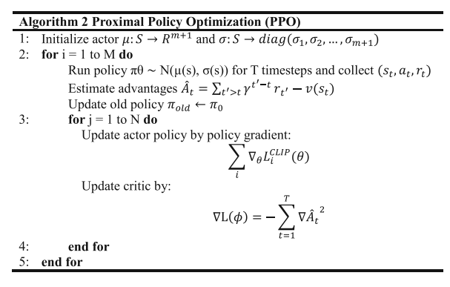
2.1.3 Proximal Policy Optimization
Figure 6. Pseudocode of PPO

Slide 15
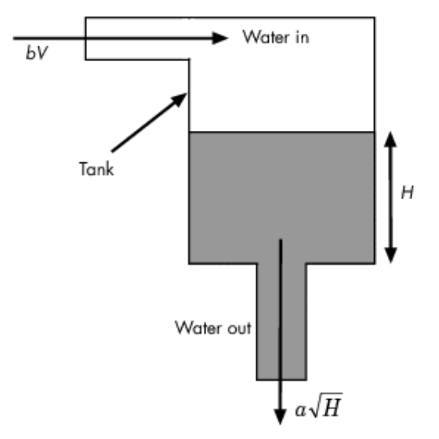
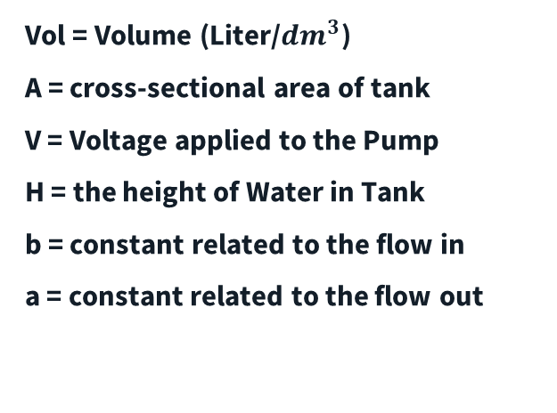
2.2. System Structure
2.2.1. Single-Tank System
Vol = Volume (Liter/${dm}^{3}$)
A = cross-sectional area of tank
V = Voltage applied to the Pump
H = the height of Water in Tank
b = constant related to the flow in
a = constant related to the flow out
Figure 7. Single-Tank System

Slide 16
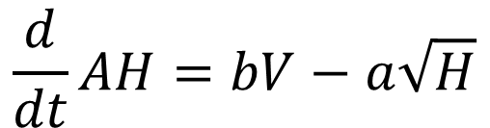
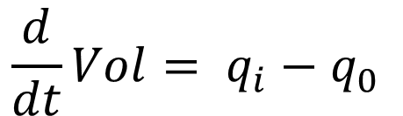
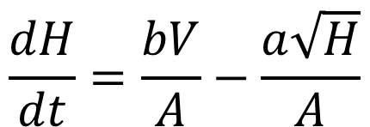
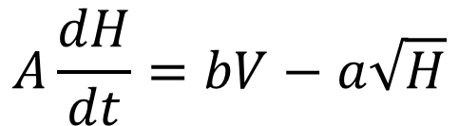
2.2. System Structure
2.2.1. Single-Tank System
$$\frac{d}{dt}Vol= q_{i}−q_{0}$$
$$\frac{d}{dt}AH=bV−a\sqrt{H}$$
$$\frac{dH}{dt}=\frac{bV}{A}−\frac{a\sqrt{H}}{A}$$
$$A\frac{dH}{dt}=bV−a\sqrt{H}$$

Slide 17
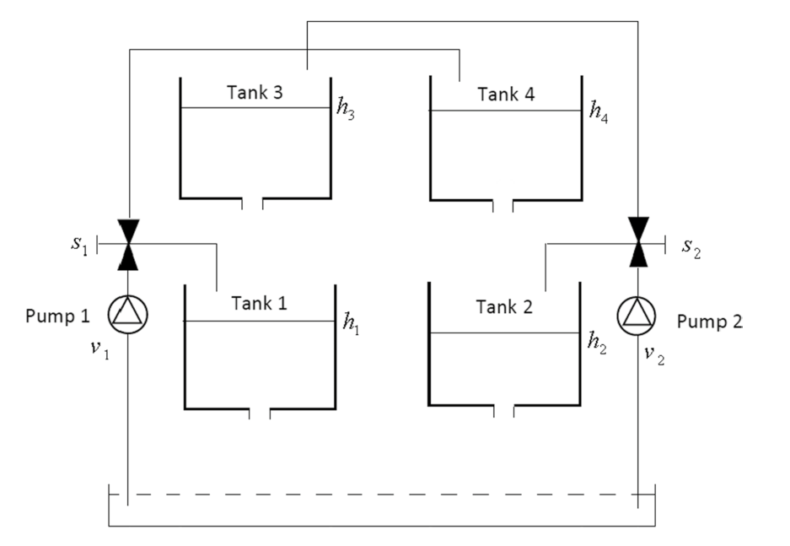
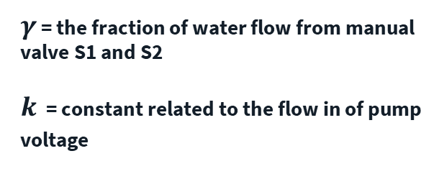
2.2. System Structure
2.2.2. Quadruple-Tank System
$γ$ = the fraction of water flow from manual valve S1 and S2
$k$ = constant related to the flow in of pump voltage
Figure 8. Quadruple-Tank System

Slide 18




2.2. System Structure
2.2.2. Quadruple-Tank System
$$\frac{{dh}_{1}}{dt}=\frac{−a_{1}}{A_{1}}\sqrt{2gh_{1}}+\frac{a_{3}}{A_{1}}\sqrt{2gh_{3}}+\frac{γ_{1}k_{1}}{A_{1}}v_{1}$$
$$\frac{{dh}_{2}}{dt}=\frac{−a_{2}}{A_{2}}\sqrt{2gh_{2}}+\frac{a_{4}}{A_{2}}\sqrt{2gh_{4}}+\frac{γ_{2}k_{2}}{A_{2}}v_{2}$$
$$\frac{{dh}_{3}}{dt}=\frac{−a_{3}}{A_{3}}\sqrt{2gh_{3}}+\frac{({1−γ}_{2})k_{2}}{A_{3}}v_{2}$$
$$\frac{{dh}_{4}}{dt}=\frac{−a_{4}}{A_{4}}\sqrt{2gh_{4}}+\frac{({1−γ}_{1})k_{1}}{A_{4}}v_{1}$$

Slide 19
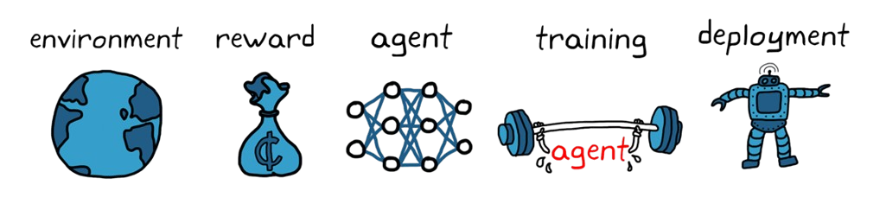
3. Methodology

Slide 20
3. Methodology
A model or simulation that represents the external system, or world, in which an agent interacts and learns

Slide 21
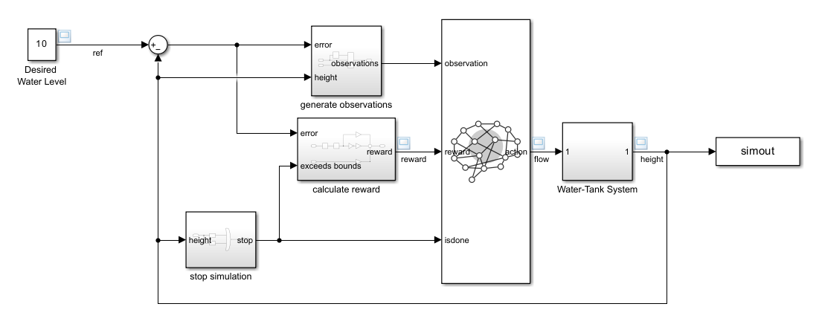
3. Methodology
Figure 9. Single-tank system

Slide 22
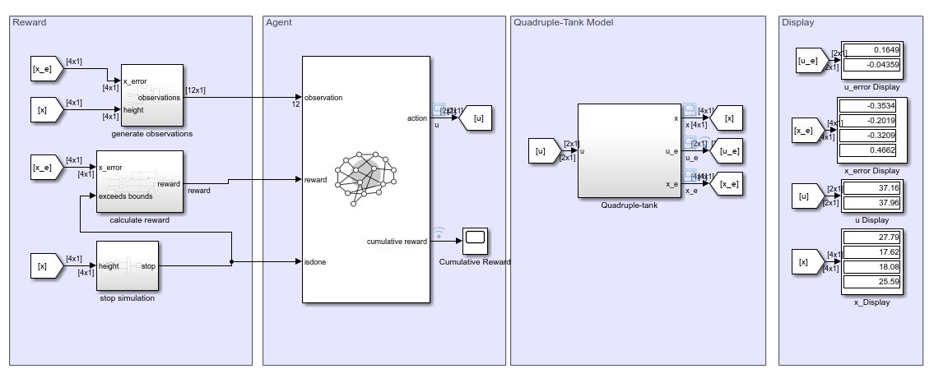
3. Methodology
Figure 10. Quadruple-Tank Model

Slide 23
3. Methodology
A scalar feedback signal it indicates how well the agent is doing

Slide 24
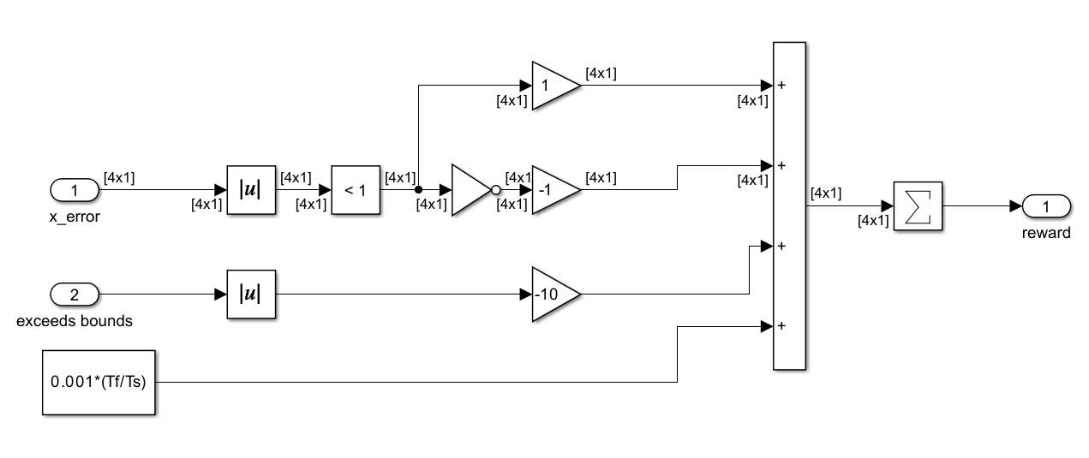
3. Methodology

Slide 25
3. Methodology
Create the agent, which consists of the policy and the reinforcement learning training algorithm

Slide 26
3. Methodology
Train the agent to tune the policy and validate the trained policy

Slide 27
3. Methodology
Deploy the trained policy

Slide 28
4. Result
4.1. Single-Tank Model
4.2. Quadruple-Tank Model

Slide 29
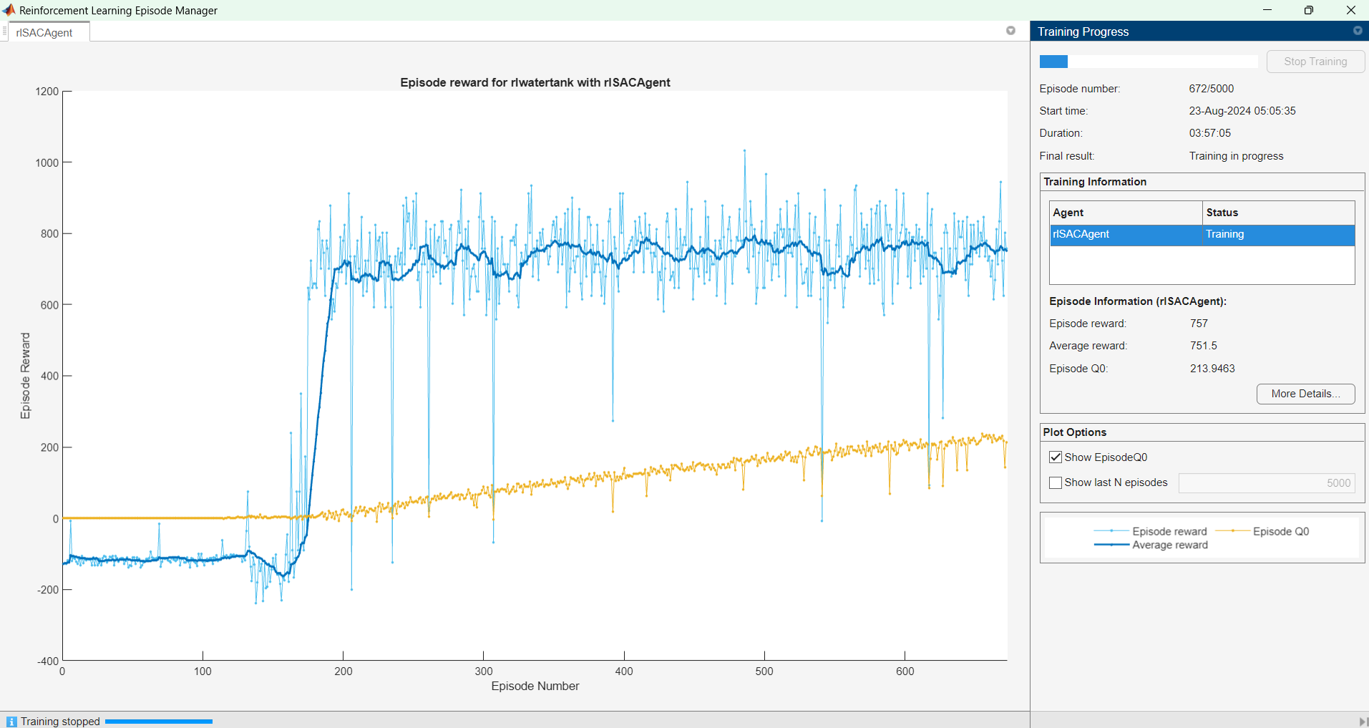
4.1. Single-Tank Model
Training : 03:57
Figure 9. Training Monitor DDPG

Slide 30
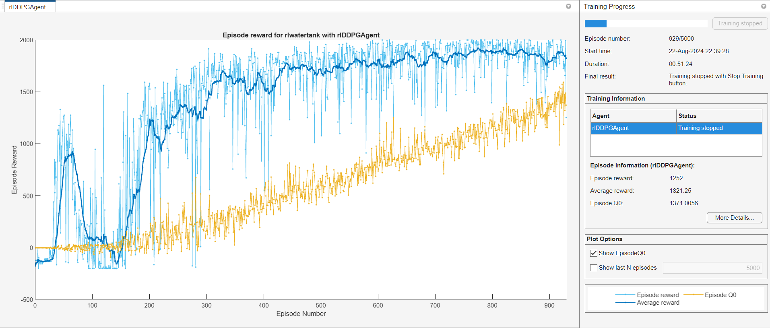
4.1. Single-Tank Model
Training : 51:24
Figure 10. Training Monitor SAC

Slide 31
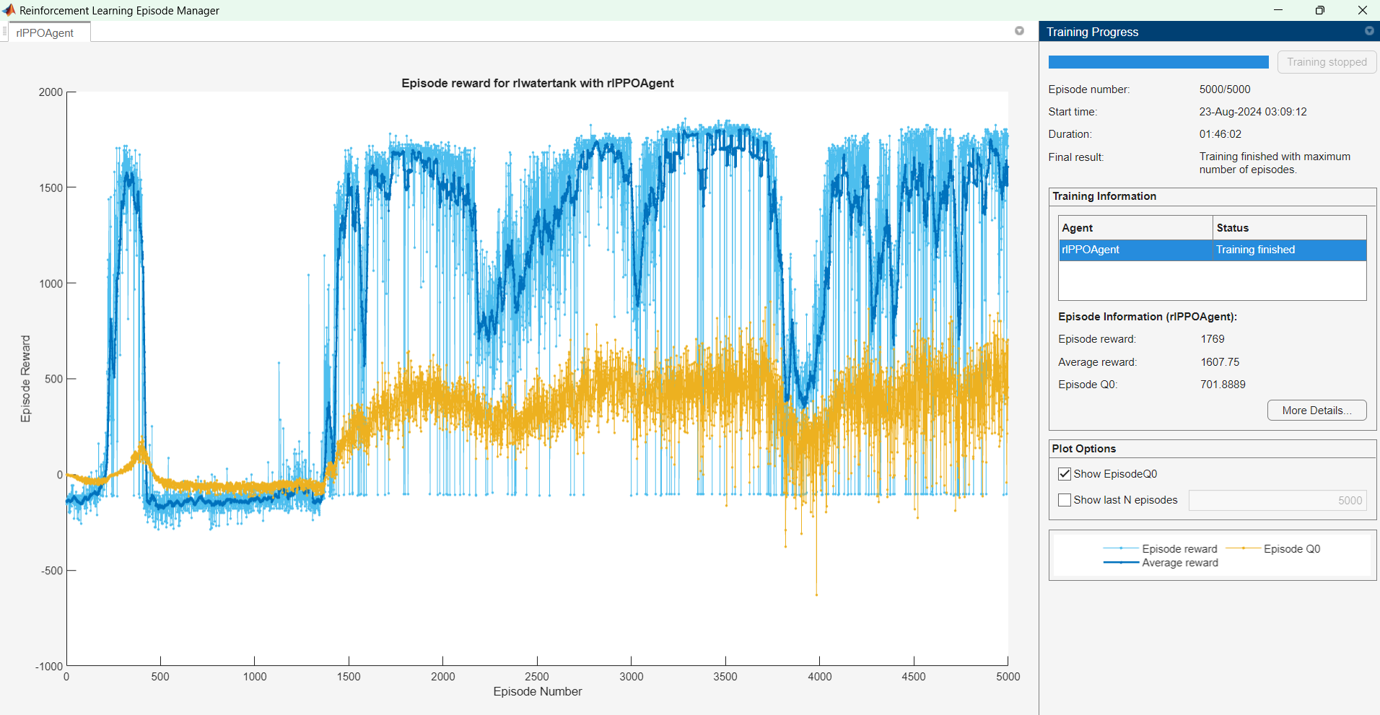
4.1. Single-Tank Model
Training: 1:46:02
Figure 11. Training Monitor PPO

Slide 32

4.1 Single-Tank Model
$$u(t)=K_{p}(e\left(t\right)+\frac{1}{T_{i}}\int_{0}^{t}{e\left(τ\right)d}τ+T_{d}\frac{N}{(1+N\frac{1}{s})})$$
The PID was tuned using MATLAB auto-tuning feature
𝐾𝑝 = 1.82,
𝐾𝑖 = 0.23,
𝐾d= 0.98, and
𝑁 = 0.73

Slide 33
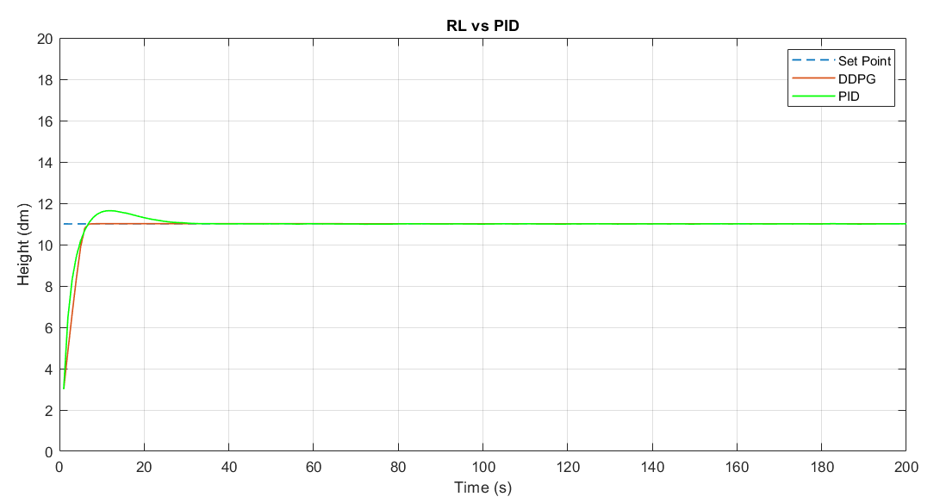
4.1 Single-Tank Model
Figure 9. Performance between PID and RL (DDPG)

Slide 34
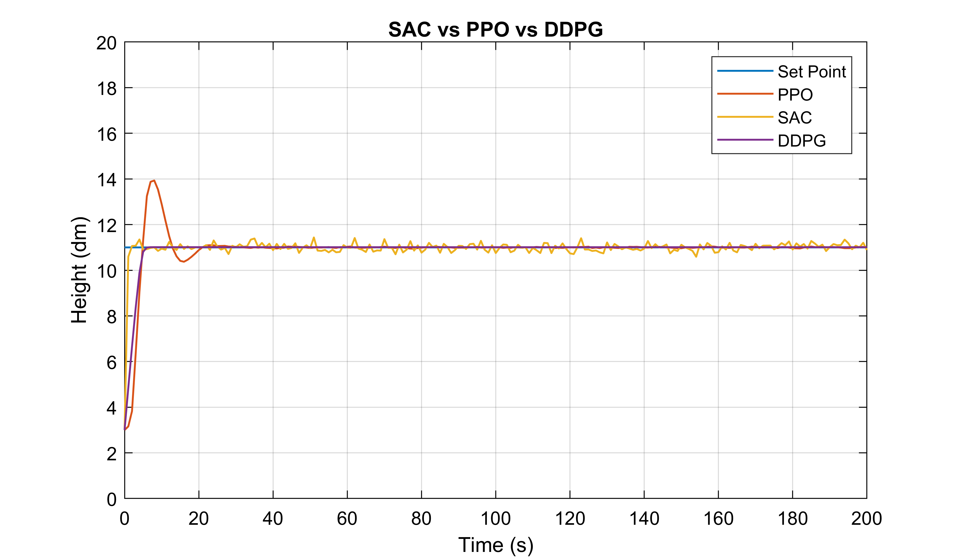
4.1 Single-Tank Model
Figure 10. Performance between SAC, PPO, and DDPG

Slide 35
4.1 Single-Tank Model
 | DDPG | SAC | PPO | PID
Rise Time | 4.8 s | 3.6 s | 4.3 s | 3.6 s
Settling Time | 6.4 s | 20.7 s | 19.4 s | 20.72 s
Overshoot | 0.021 | 5.7 | 26.4 | 5.7
Undershoot | 0 | 0 | 0 | 0
Peak | 10.03 | 11.6 | 13.9 | 11.64
Peak Time | 11 s | 11 s | 8 s | 11 s

Slide 36
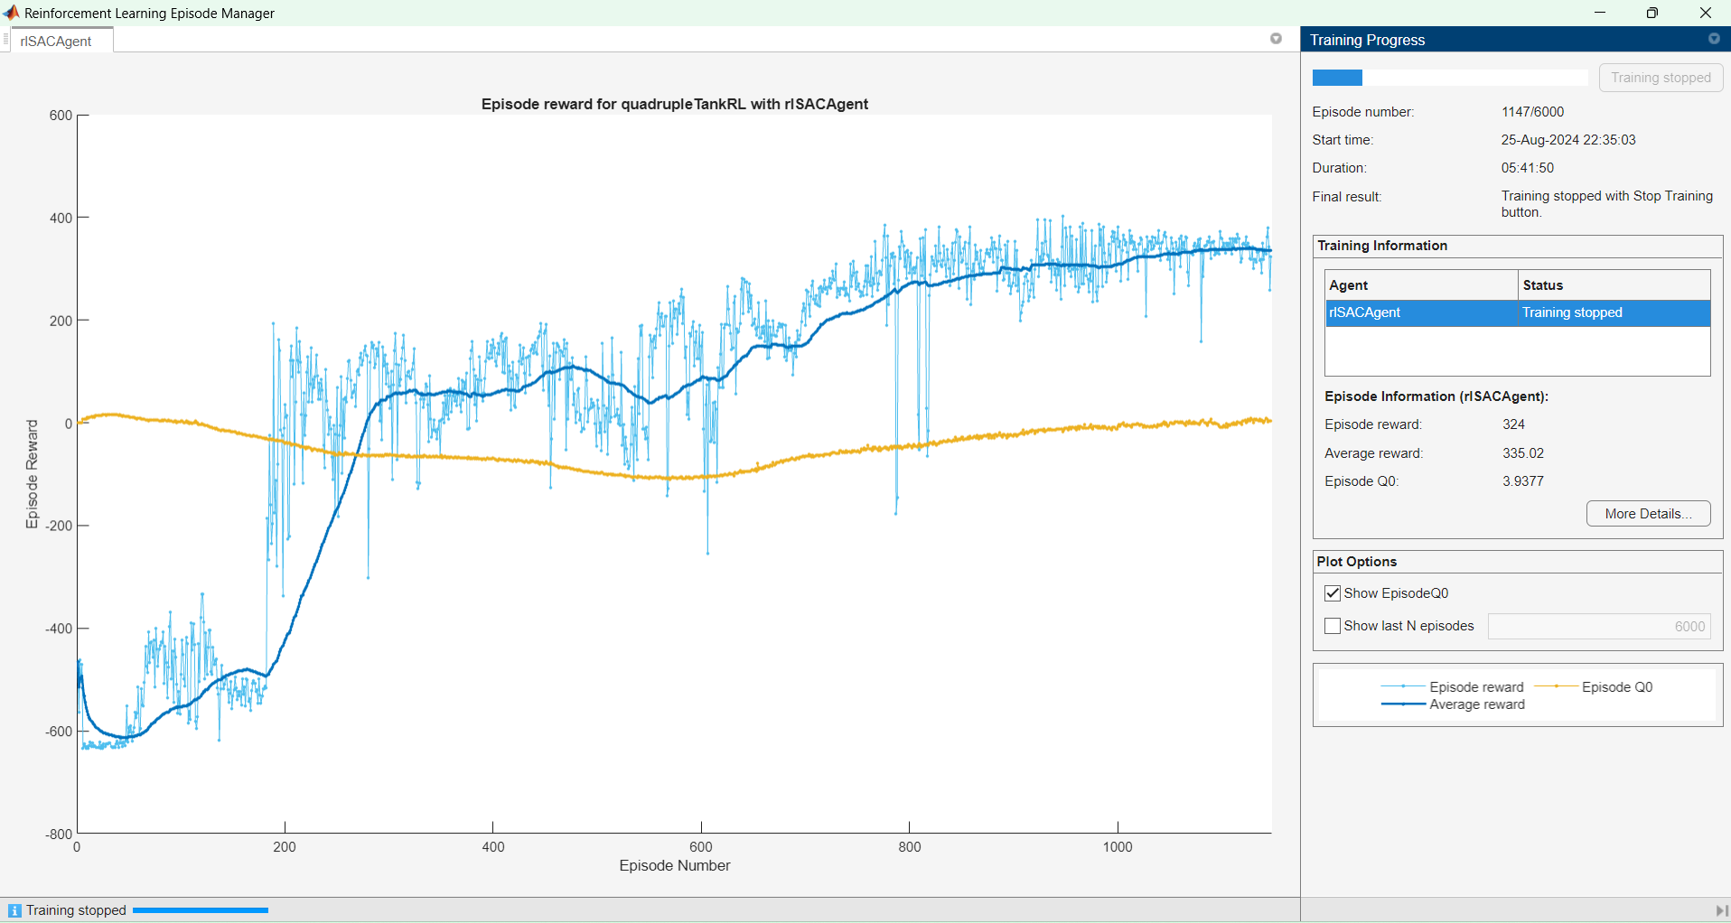
4.2 Quadruple-Tank Model
Training: 05:41:50
Figure 11. Training Monitor SAC

Slide 37
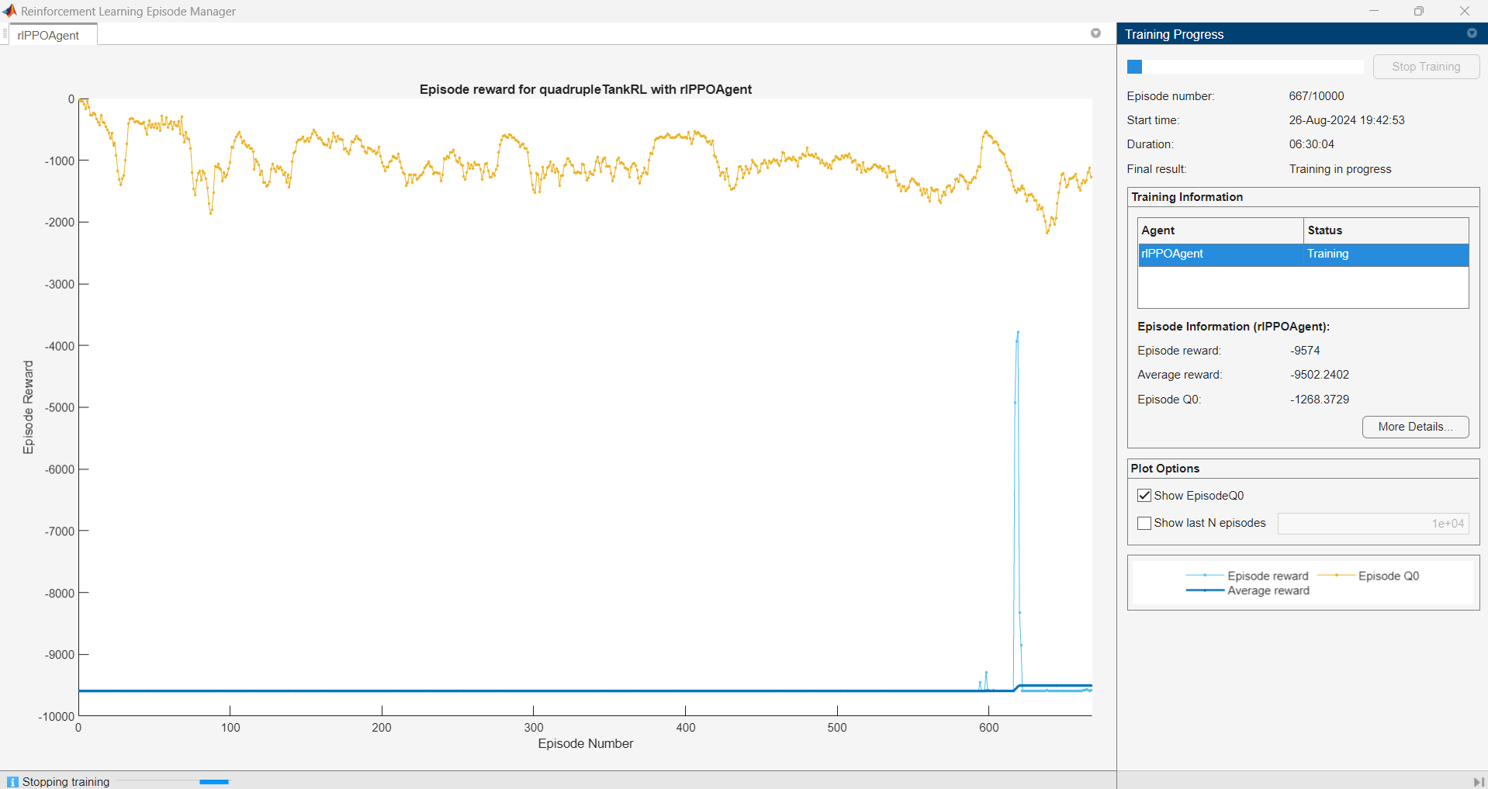
4.2 Quadruple-Tank Model
Figure 12. Training Monitor PPO

Slide 38
4.1 Single-Tank Model
 | SAC (x1) | SAC (x2) | SAC (x3) | SAC (x4)
Rise Time | 3.6 s | 3.6 s | 3.6 s | 3.6 s
Settling Time | 20.7 s | 20.7 s | 20.7 s | 20.7 s
Overshoot | 5.7 | 5 | 6.3 | 6.9
Undershoot | 0 | 0 | 0 | 0
Peak | 11.6 | 11.6 | 11.6 | 11.6
Peak Time | 11 s | 11 s | 11 s | 11 s

Slide 39
5. Discussion
In the single-tank system,
SAC exhibited a more favorable performance profile in terms of rise time and overshoot. While PPO demonstrated a quicker rise time, it was accompanied by a higher overshoot. Nonetheless, both methods ultimately converged to a stable equilibrium.

Slide 40
5. Discussion
In the quadruple-tank system,
SAC exhibited a more favorable performance profile in terms of rise time and overshoot with longer period of training. While PPO demonstrated divergency since the implementation of Continuous Gaussian Actor.

Slide 41
Any questions?
mmibrahim2@Sheffield.ac.uk

